Slide 1
Create forms and reports in MS Access
Week 7
Dr. Farshid Keivanian

Slide 2
Week 7 Outline
Introduction
Role of Forms
Hands-On Activity 1: Creating a Customer Form
Generating Forms
Hands-On Activity 2: Building a Products Form with Search
Compare Wizard vs Design View
Reports — Customers with their Orders
Compact/Repair, Password, Backup
Tutorial Preparation (Week 7)
What to Submit
What to Avoid
Discussion & Debate Questions
Problem-Solving Examples

Slide 3
Introduction
Topic: Forms & Reports in MS Access
What we’ll do today
Learn how to make databases user-friendly with forms
Create reports to summarise and present data
Add simple navigation (main menu)
Discuss database maintenance (backups, passwords)

Slide 4
Introduction
Why it matters
Tables are for storage → but users need friendly screens
Reports turn raw data into professional documents
Skills useful for real business tasks (e.g., invoices, order lists, staff reports in Australia)

Slide 5
Introduction
Analogy (Australia):
A Medicare card form = entering info through a form
A Woolworths receipt = a report generated from transactions

Slide 6
Role of Forms
Role of Forms
Forms are the friendly face of a database. Instead of typing into raw tables, you use a neat screen to enter and view data.
Analogy (Australia) Like a Medicare form — you don’t see the big system behind it, just a simple sheet asking for name, address, Medicare number.

Slide 7
Role of Forms
Why use forms?
Reduce mistakes
Make data entry easier
Allow built-in checks (validation)
Example
Table: Customer
Form: Screen to type customer name, email, postcode

Slide 8
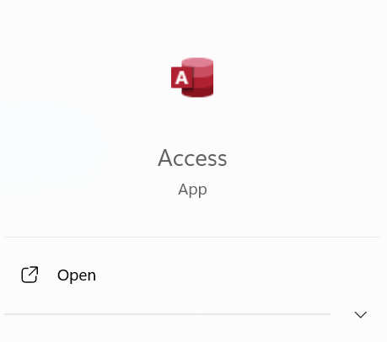
Hands-On Activity 1: Creating a Customer Form
Step 1: Open Your Database
Open Access.

Slide 9
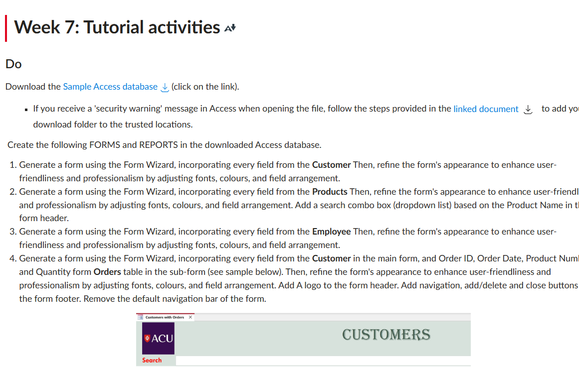
Hands-On Activity 1: Creating a Customer Form
Download Module 6&7 DB.accdb file from Canvas

Slide 10
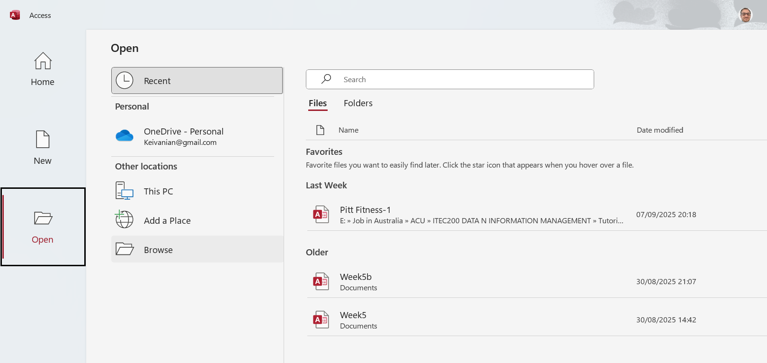
Hands-On Activity 1: Creating a Customer Form
Open the Tutorial Week 7 database.

Slide 11
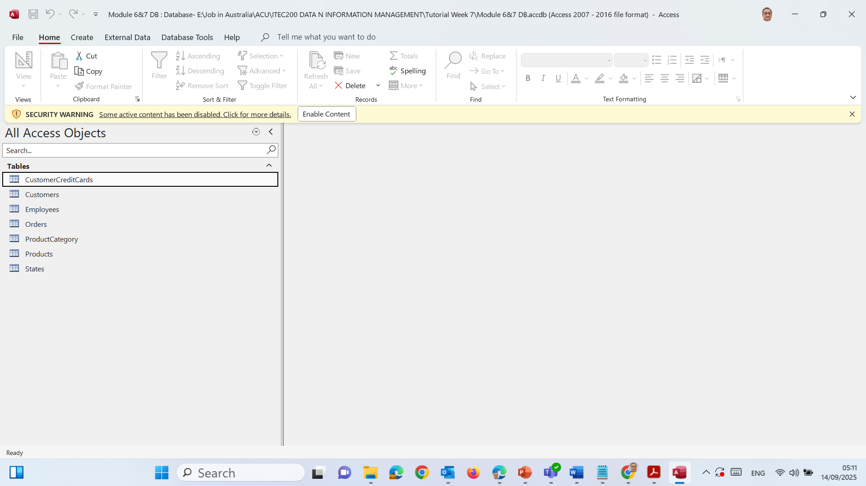
Hands-On Activity 1: Creating a Customer Form
Turn on content
At the top yellow bar, click Enable Content.

Slide 12
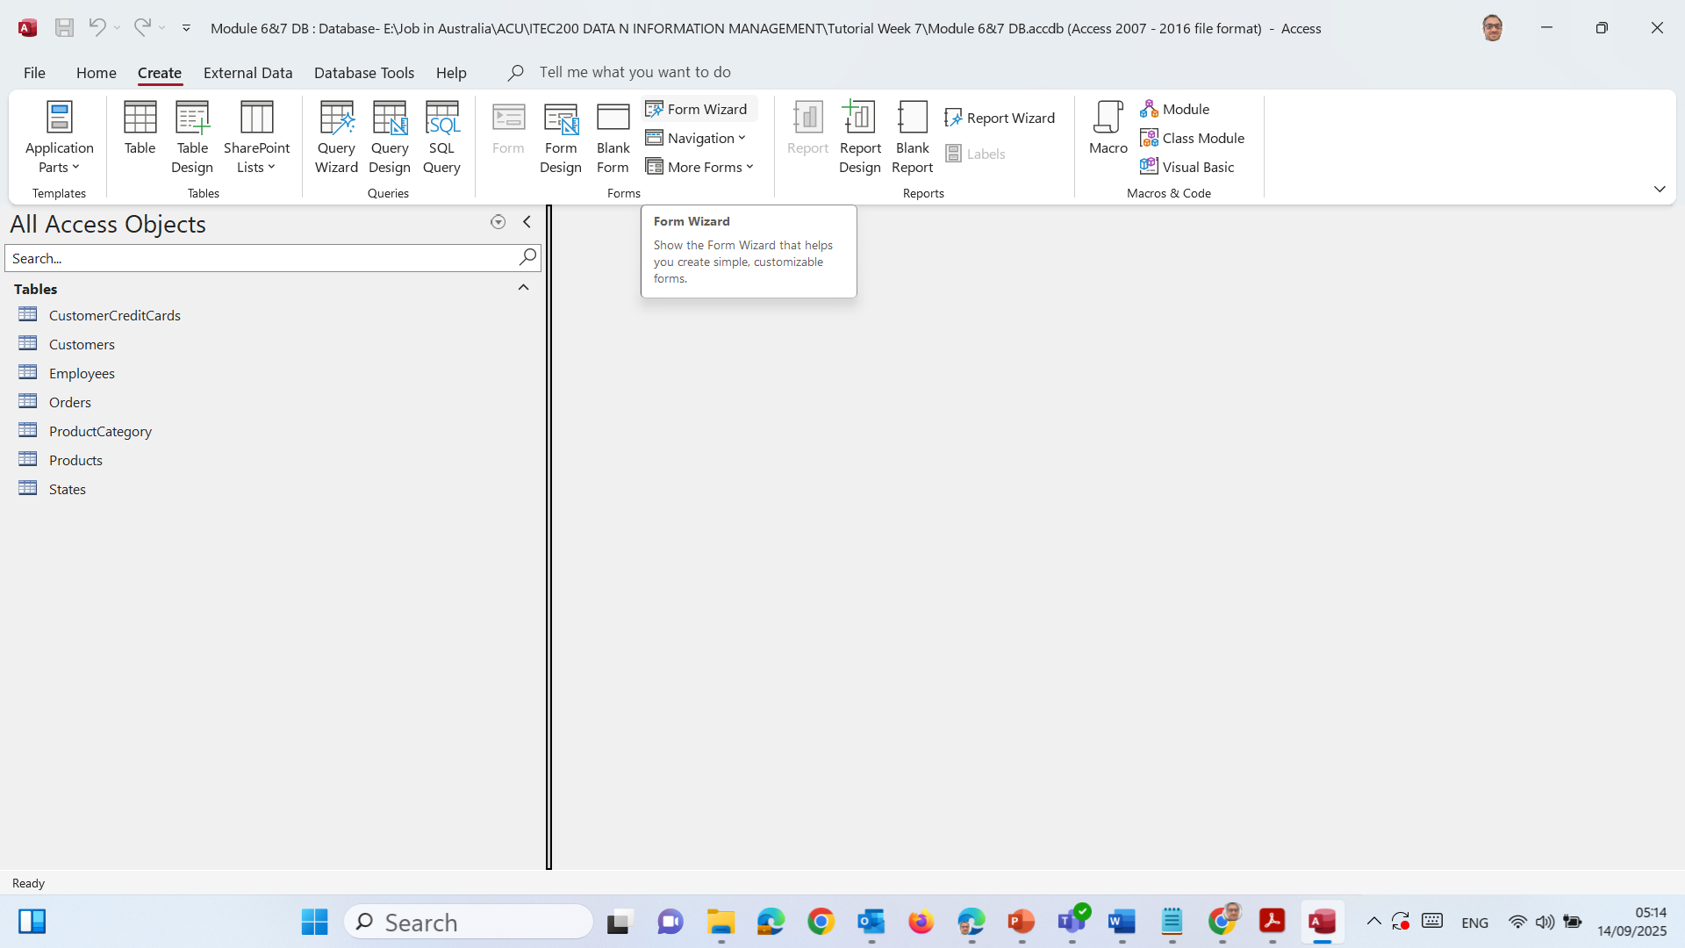
Hands-On Activity 1: Creating a Customer Form
Open the Form Wizard
Go to Create tab.

Slide 13
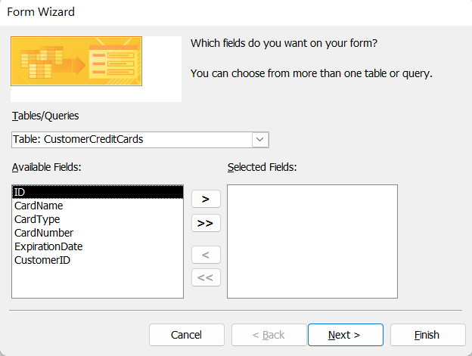
Hands-On Activity 1: Creating a Customer Form
Click Form Wizard

Slide 14
Hands-On Activity 1: Creating a Customer Form
6) Pick the source and fields
In Tables/Queries, choose Table: CustomerCreditCards.

Slide 15
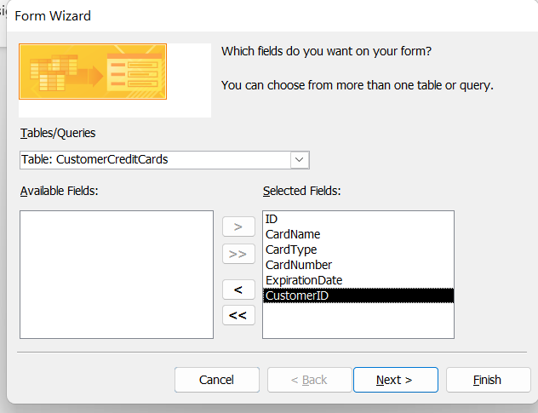
Hands-On Activity 1: Creating a Customer Form
Move these fields to Selected Fields

Slide 16
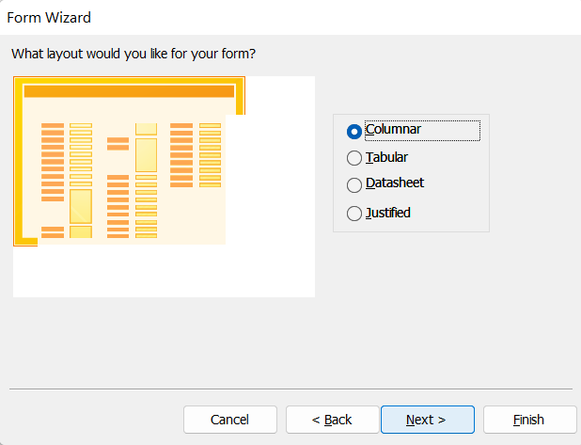
Hands-On Activity 1: Creating a Customer Form
Click Next → choose Columnar layout → Next.

Slide 17
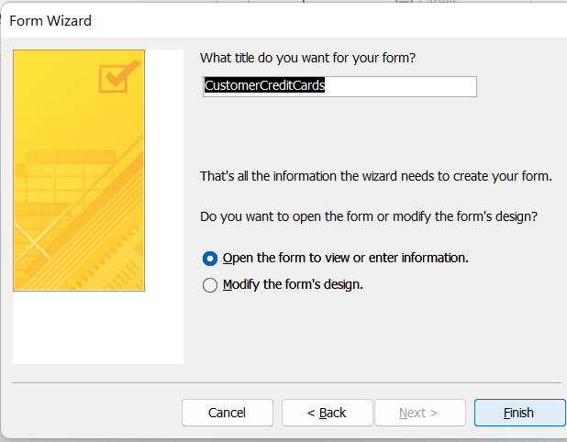
Hands-On Activity 1: Creating a Customer Form
Name it CustomerCreditCards → Finish.

Slide 18
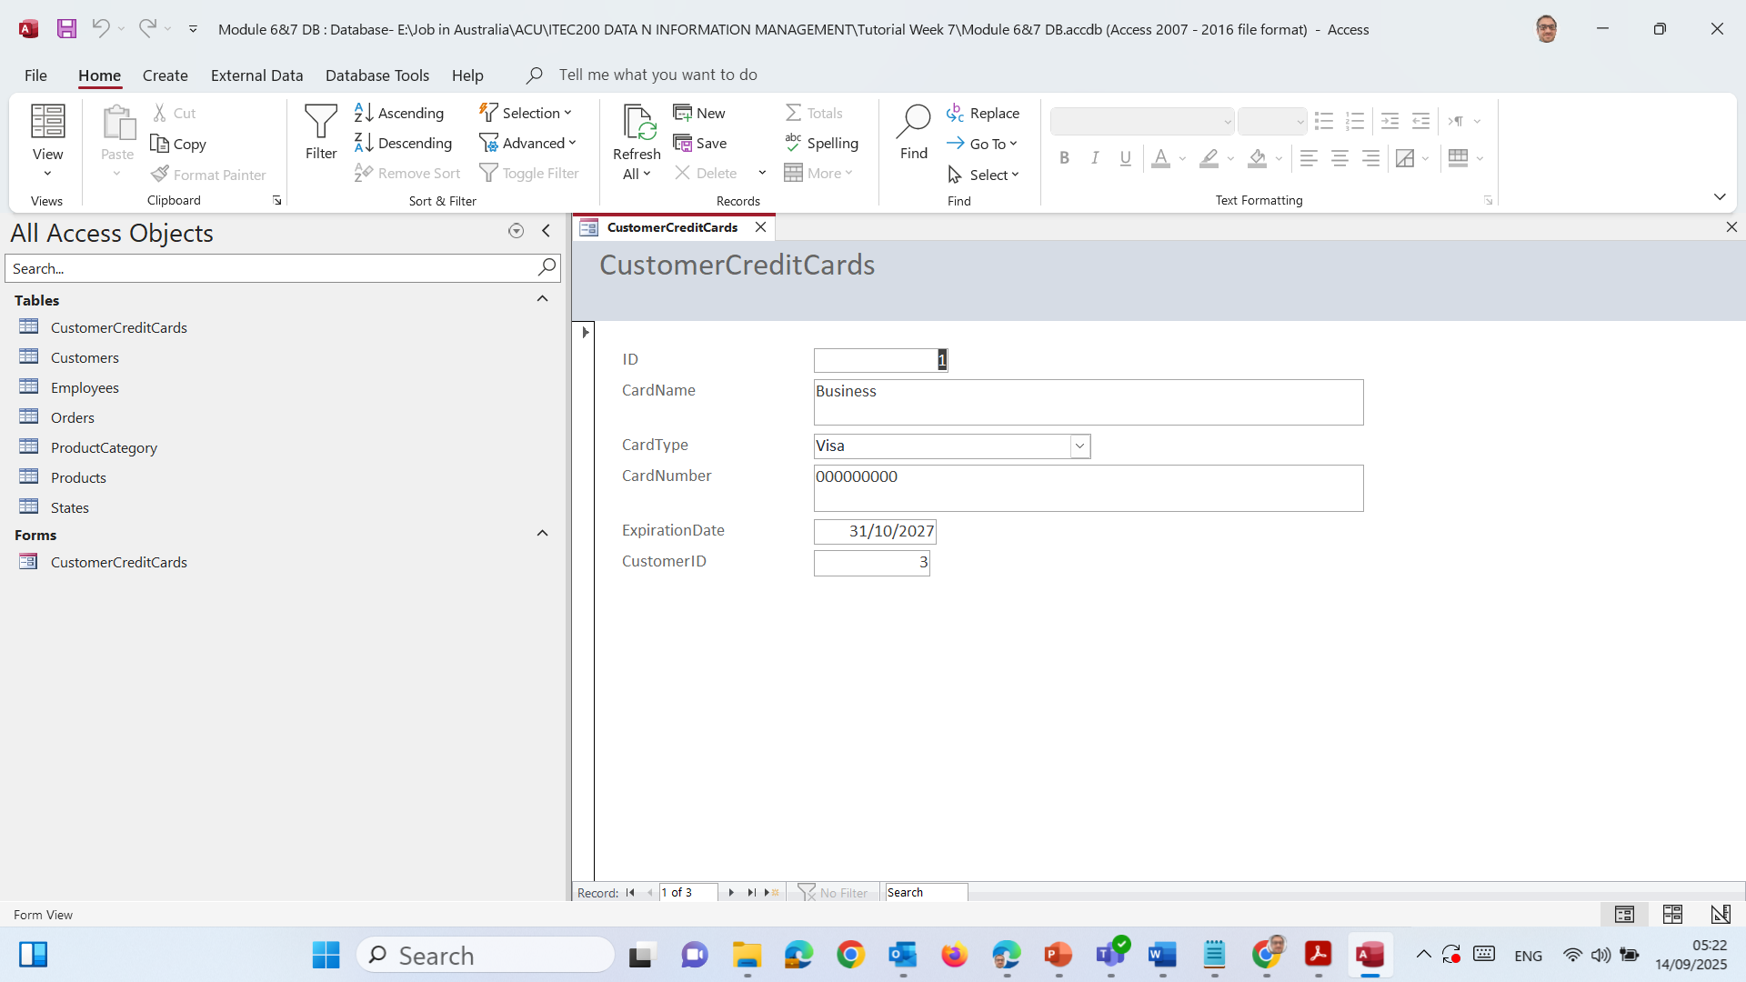
Hands-On Activity 1: Creating a Customer Form

Slide 19
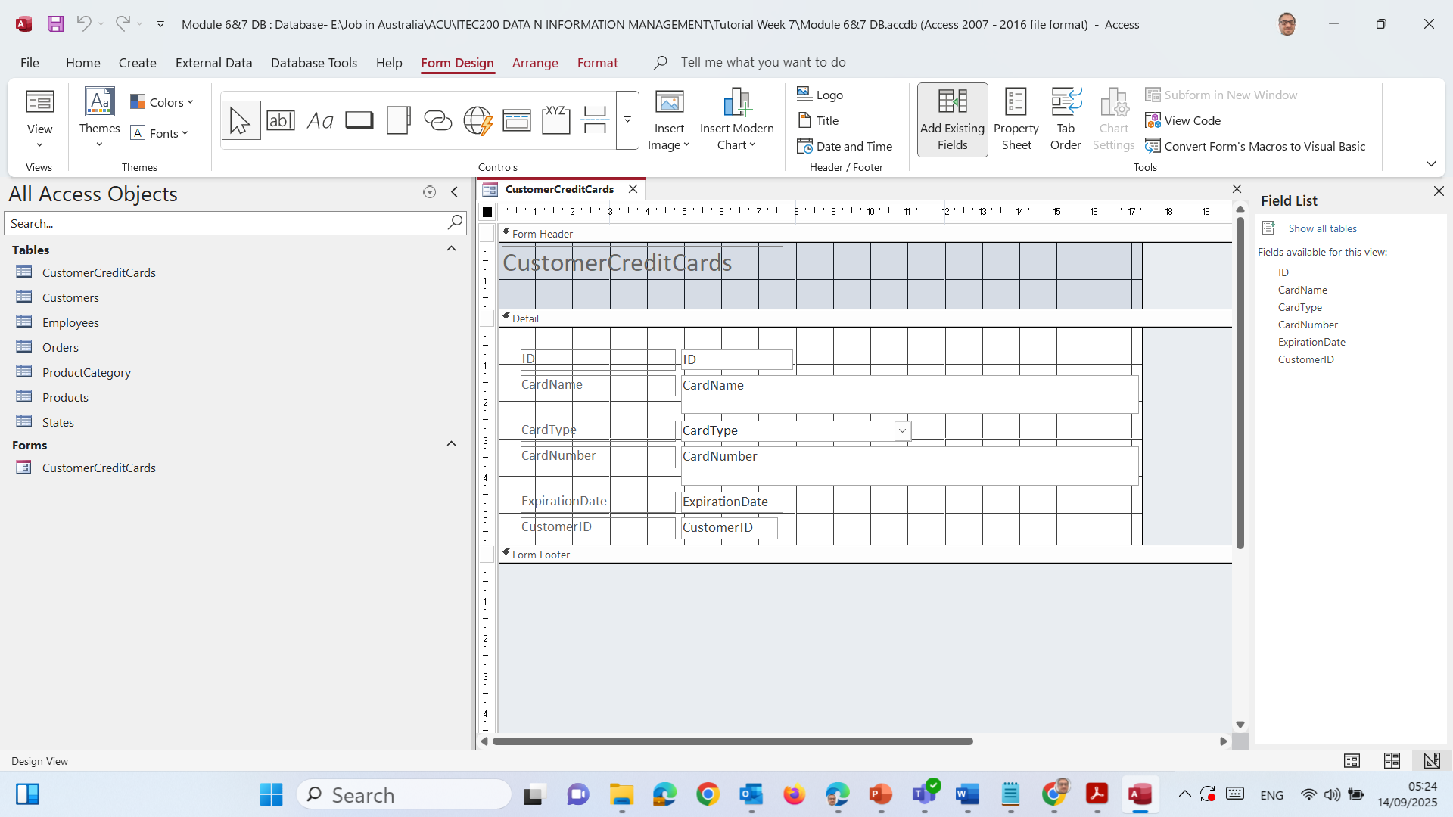
Hands-On Activity 1: Creating a Customer Form
7. Make it nicer (colours & fonts)
Switch to Design View (top-left view drop-down).

Slide 20
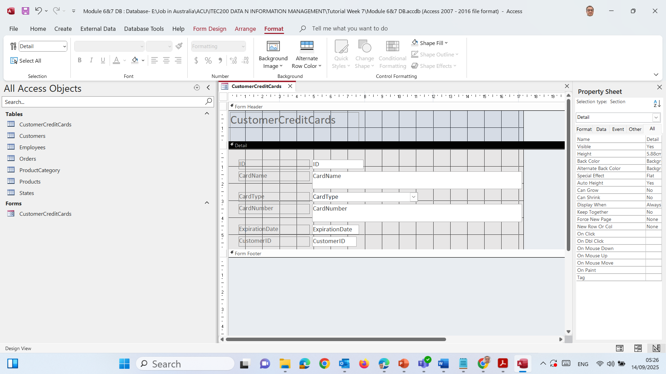
Hands-On Activity 1: Creating a Customer Form
Click on Format tab → choose a Background Color.

Slide 21
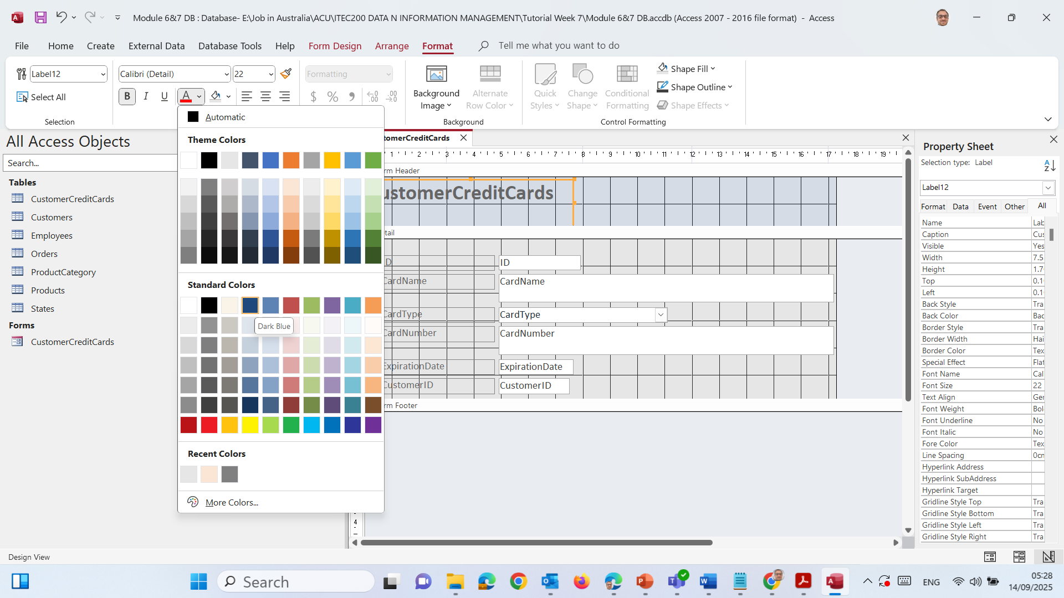
Make the title stand out
Click once on the grey box that says CustomerCreditCards (the title label in the header).

Slide 22
In the Format tab:
Change Font Size (e.g., 22–24).
Make it Bold.
Optional: Change the Font Colour (e.g., dark blue)

Slide 23
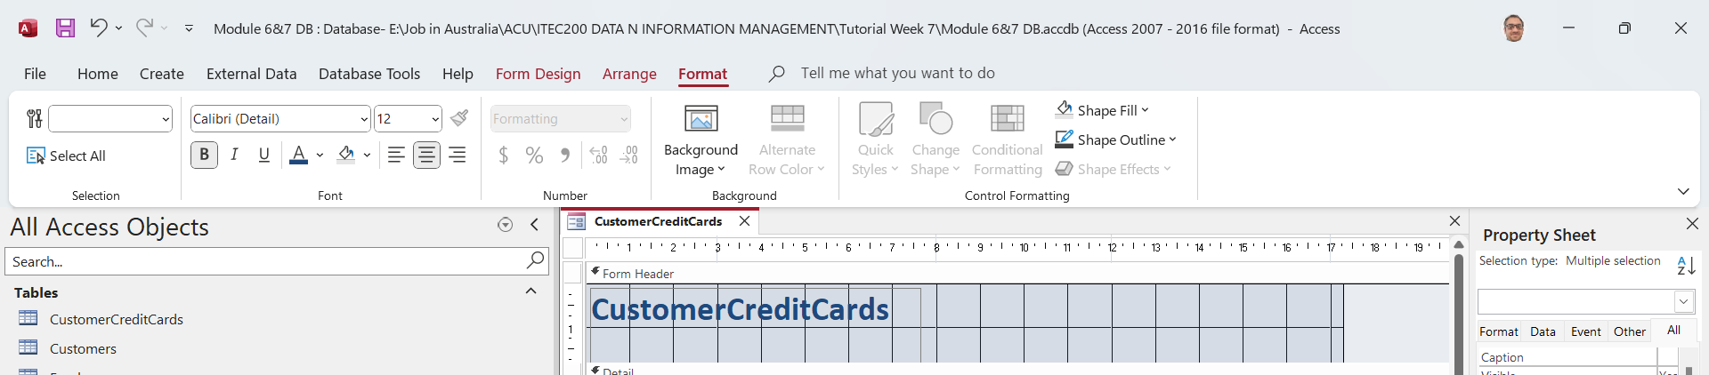
Hands-On Activity 1: Creating a Customer Form

Slide 24
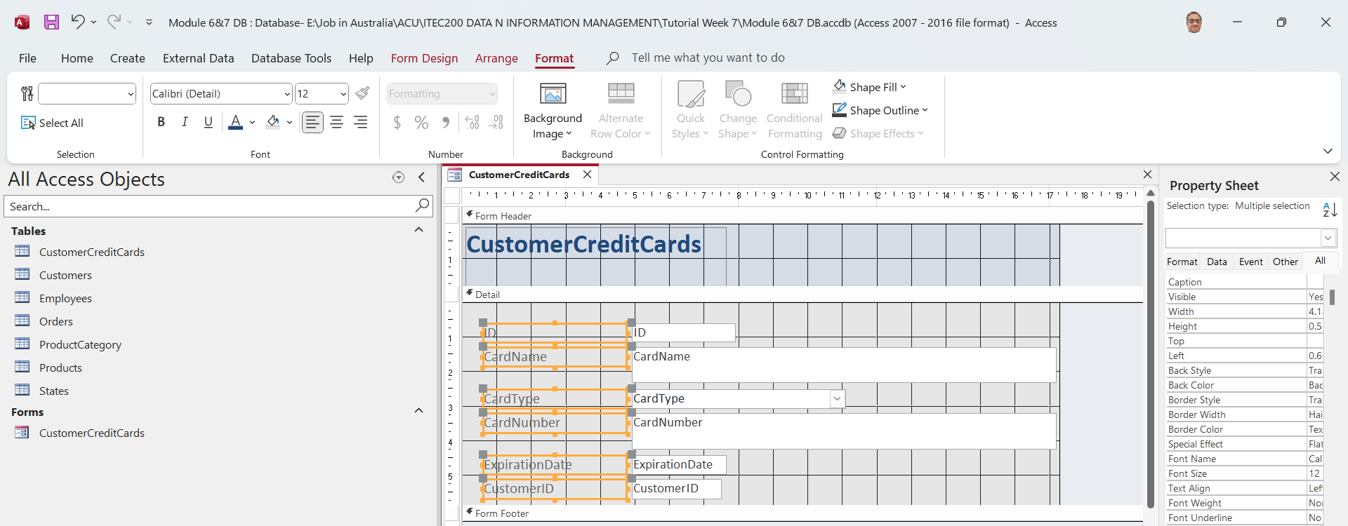
Hands-On Activity 1: Creating a Customer Form
Improve the field labels
Hold Ctrl and click the labels (e.g., ID, CardName, CardType, CardNumber…).

Slide 25
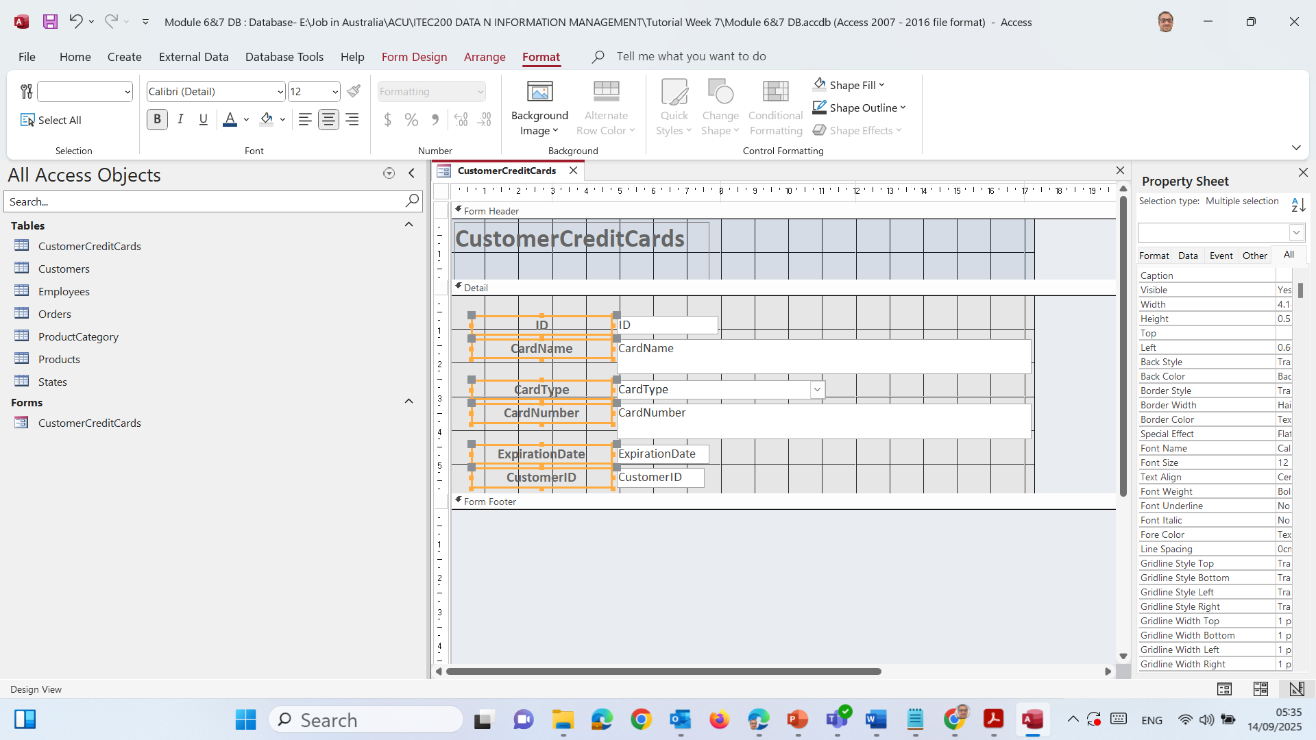
In the Format tab:
Change Font Size to 12–14pt.
Make them Bold if you like.
Align them neatly using the Arrange → Align tools.

Slide 26
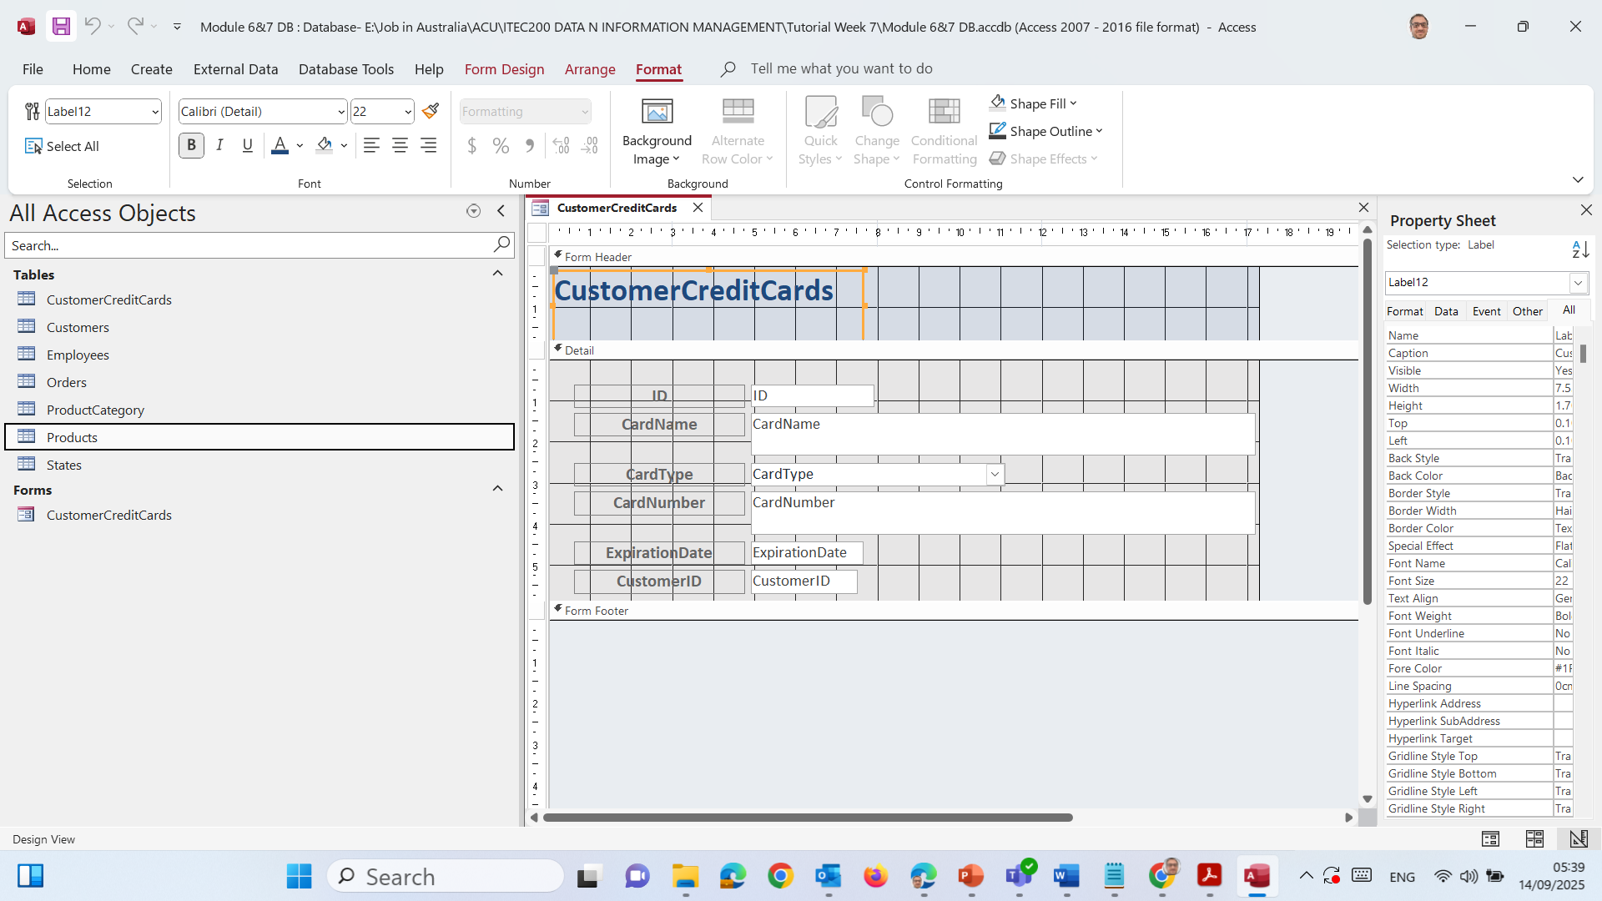
Save the Form
Press Ctrl+S (or click the floppy disk icon in the top-left).
Make sure the form name is something clear like CustomerCreditCards Form.

Slide 27
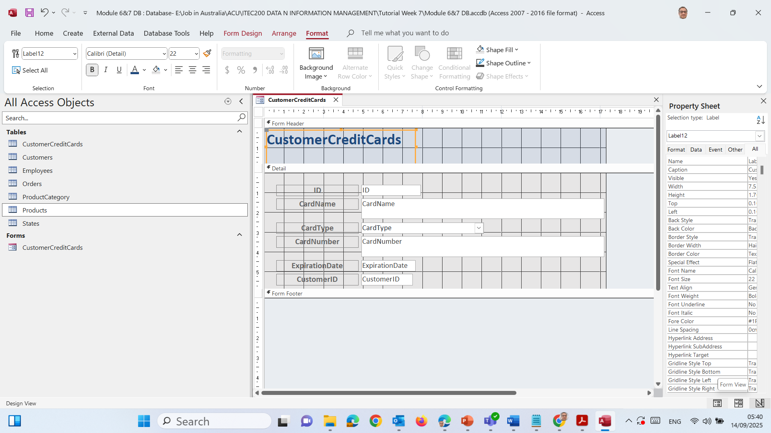
Switch to Form View
Select Form View. → This will show you how the form looks to users.

Slide 28
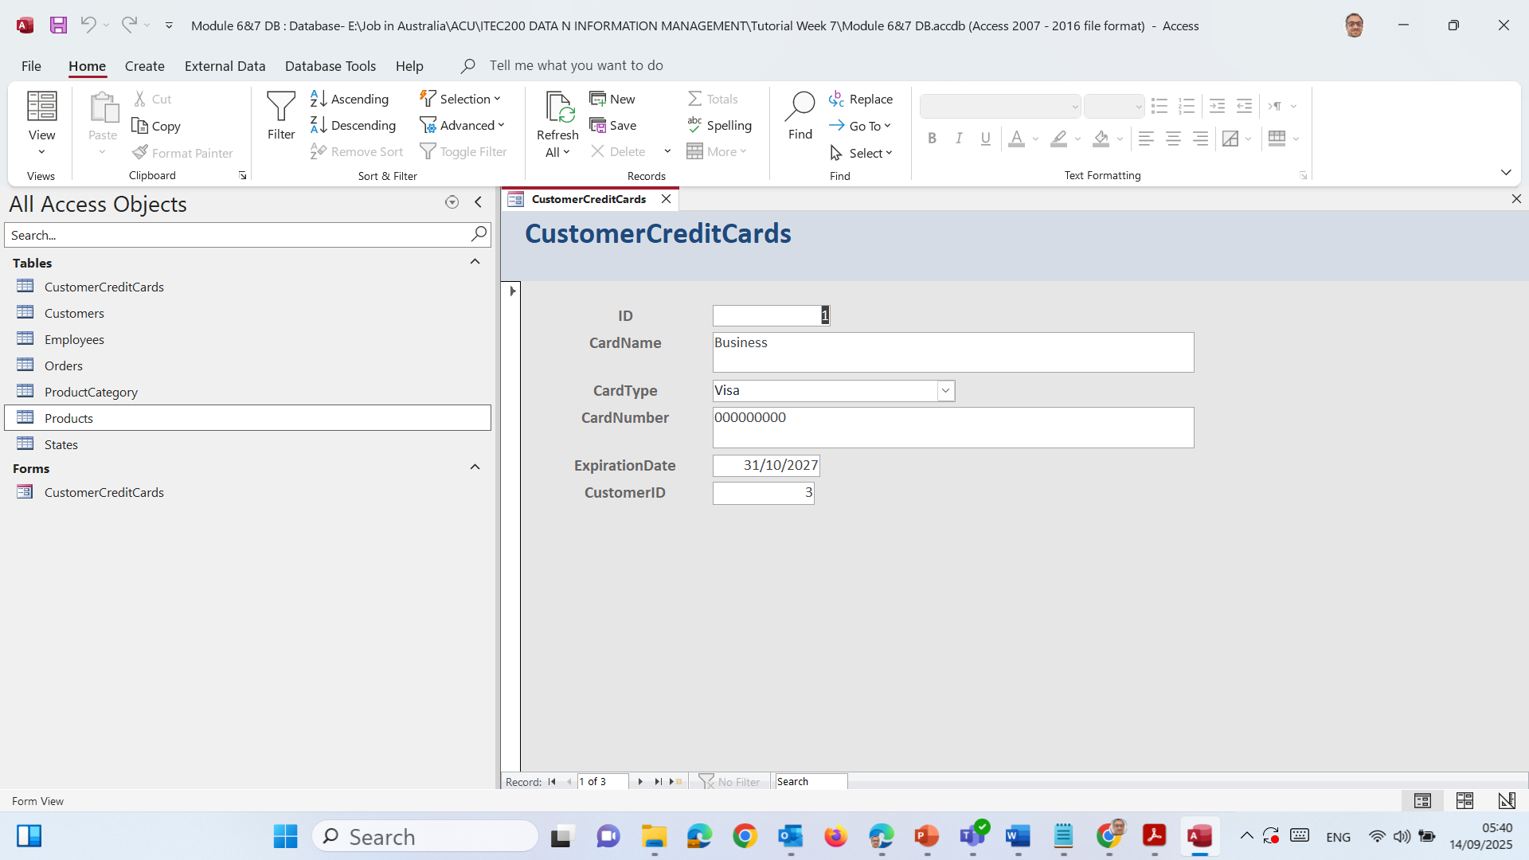
Switch to Form View
Select Form View. → This will show you how the form looks to users.

Slide 29

Test by Adding a Record
In Form View, go to the empty fields at the bottom.
Type in some test details (e.g., CardName = “Farshid”, CardType = “MasterCard”, CardNumber = “123456”, ExpirationDate = “31/12/2026”, CustomerID = 1).

Slide 30
Press Tab or click the Next record arrow at the bottom to save (Fill it, e.g., Enter Your Name).

Slide 31
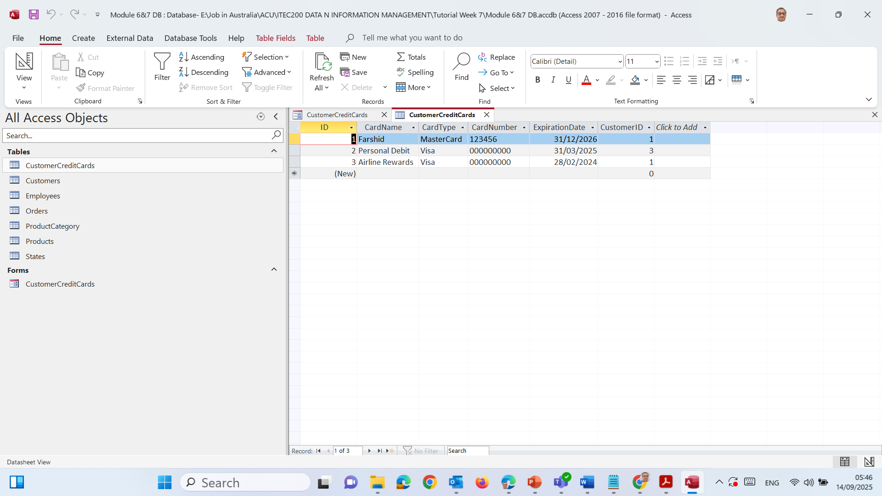
Open the CustomerCreditCards table (from left side) → check if your test record was saved.

Slide 32
Generating Forms
Form Wizard: quick and automatic.
Form Design View: full control for layout.
Example:
From the Products table → Build a form.
Add a dropdown for Category.

Slide 33
Generating Forms
Comparison Table
Wizard | Design View
Fast, auto-layout | Manual, more control
Limited flexibility | Full customisation
Good for beginners | Good for polished results

Slide 34
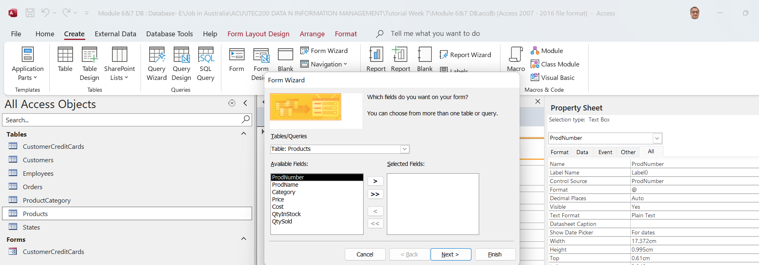
Hands-On Activity 2: Building a Products Form with Search
Step 1: Create a Products Form with Wizard
Go to the Create tab.
Click Form Wizard.

Slide 35
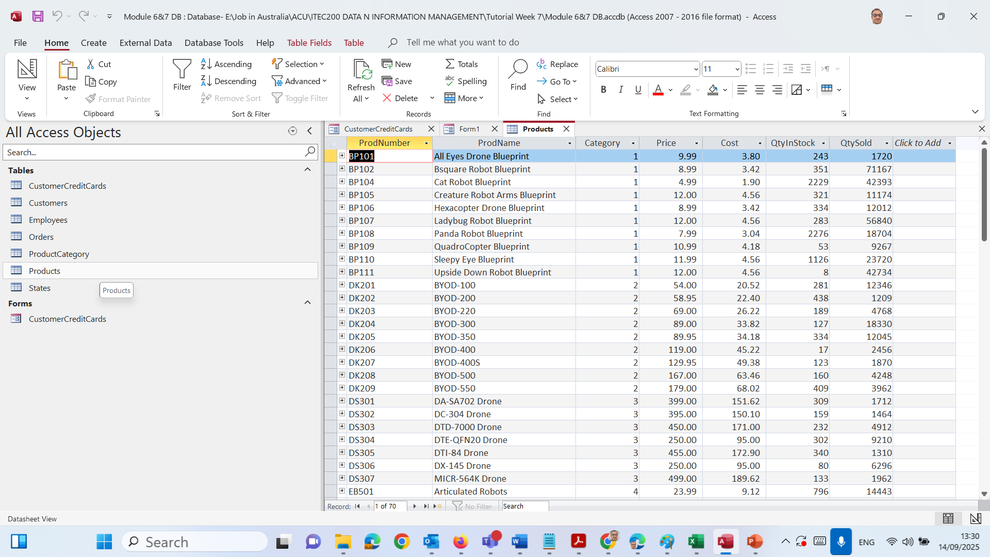
Hands-On Activity 2: Building a Products Form with Search
In Tables/Queries, pick Table: Products.

Slide 36
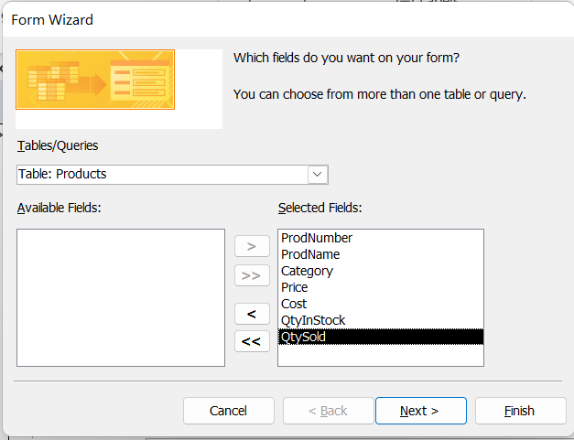
Hands-On Activity 2: Building a Products Form with Search
Move all fields to the right (>>).

Slide 37
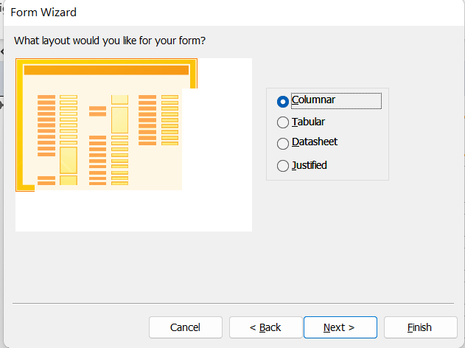
Hands-On Activity 2: Building a Products Form with Search
Click Next → Choose Columnar layout → Next.
Name it Products Form → Finish. → Access will open the Products form automatically.

Slide 38
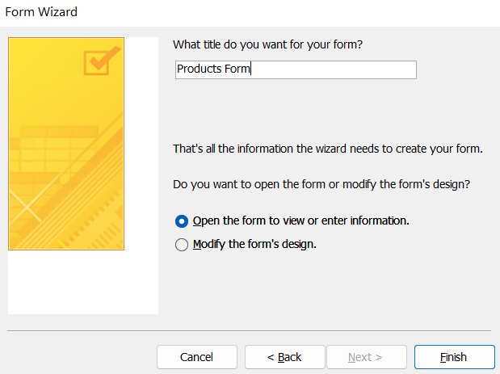
Hands-On Activity 2: Building a Products Form with Search
Click Next → Choose Columnar layout → Next.
Name it Products Form → Finish. → Access will open the Products form automatically.

Slide 39
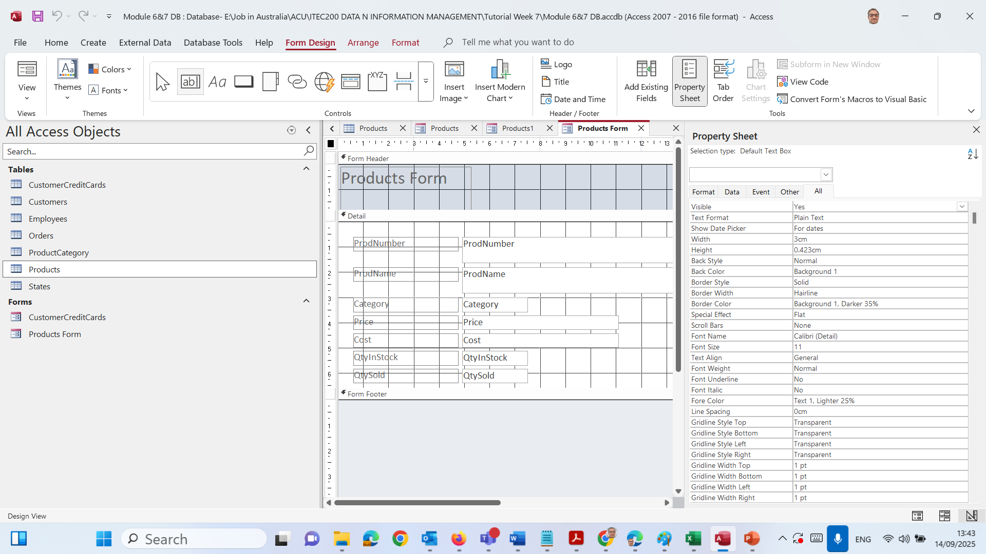
Hands-On Activity 2: Building a Products Form with Search
Step 2: Add a Search Box (Design View)
Switch to Design View.
On the Design tab, click Text Box.

Slide 40
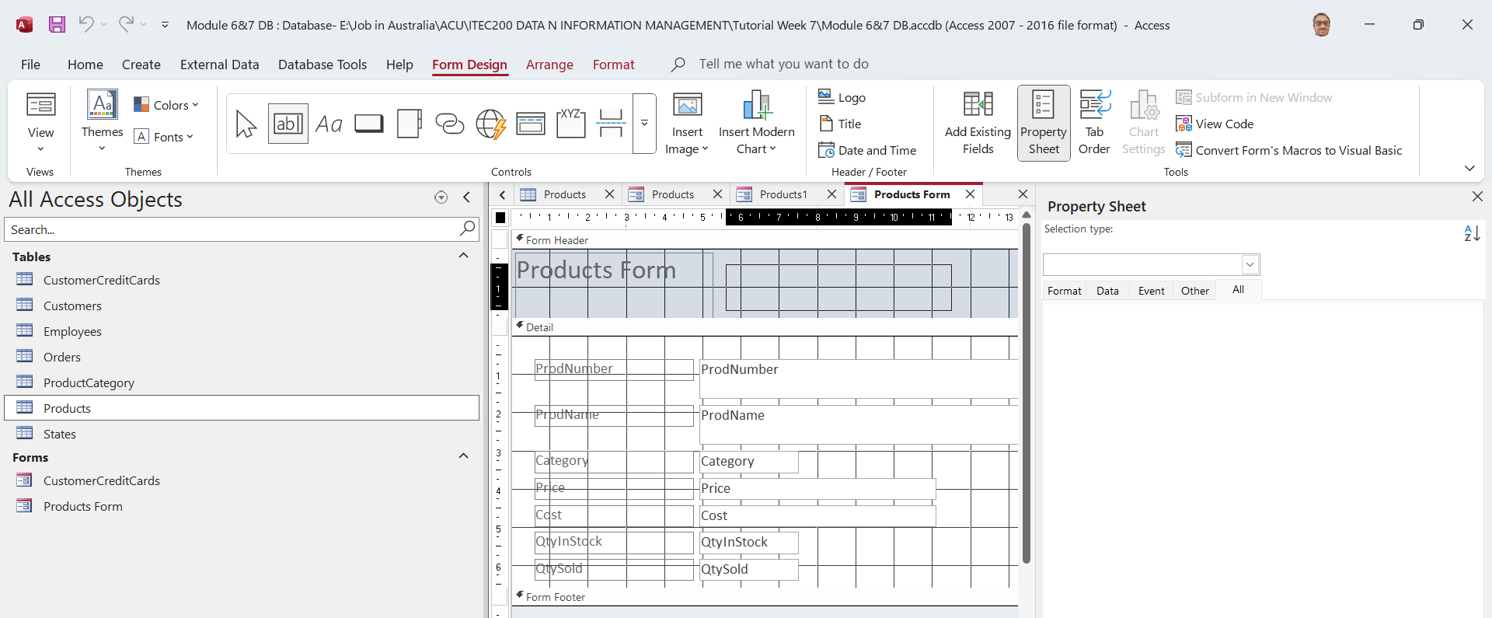
Hands-On Activity 2: Building a Products Form with Search
Draw a box in the Form Header area.

Slide 41
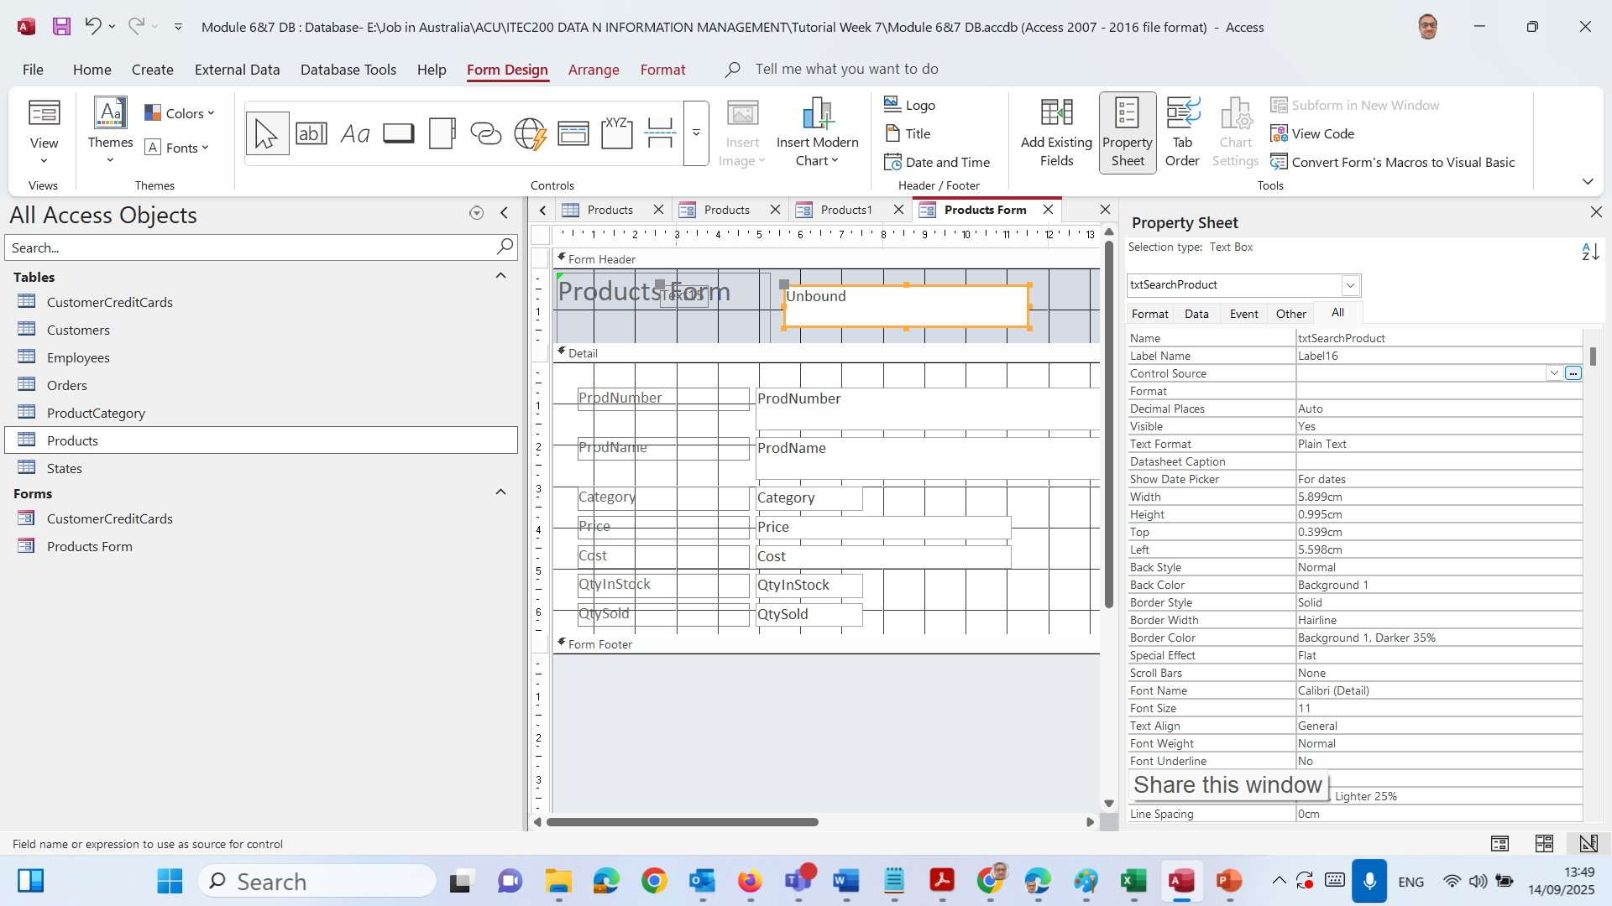
Hands-On Activity 2: Building a Products Form with Search
Select the new text box → right-click → Properties.
In the Other tab: set Name = txtSearchProduct.

Slide 42
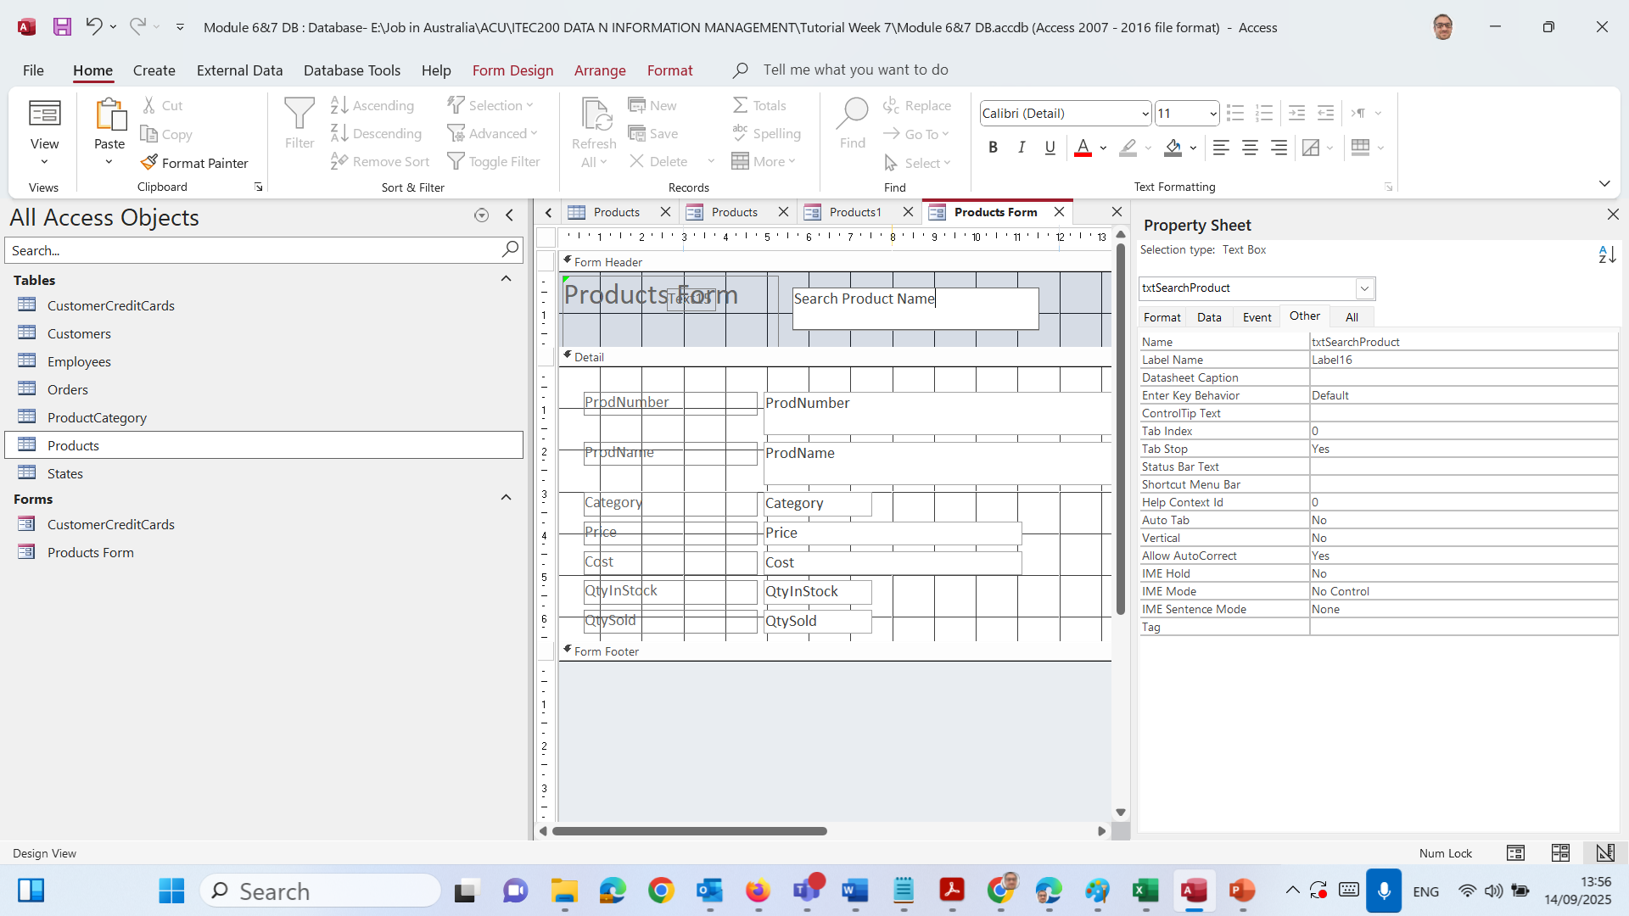
Hands-On Activity 2: Building a Products Form with Search
Just Type directly into text box and Replace ‘Unbound’ with ‘Search Product Name’

Slide 43
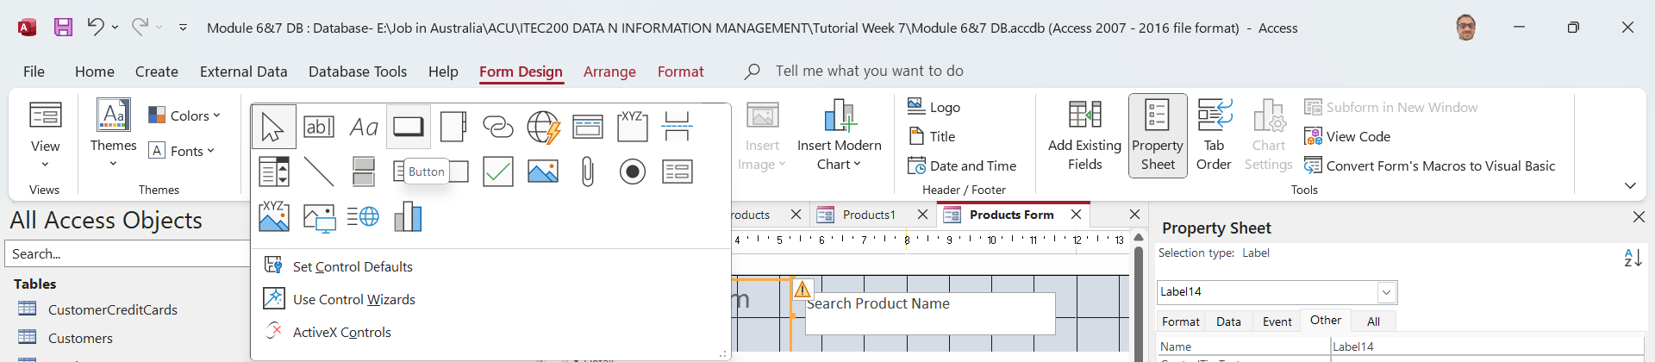
Hands-On Activity 2: Building a Products Form with Search
Add the Command Button
Make sure Use Control Wizards (wand icon in your screenshot) is ticked ON.
From the Design tab, click the Button tool.

Slide 44
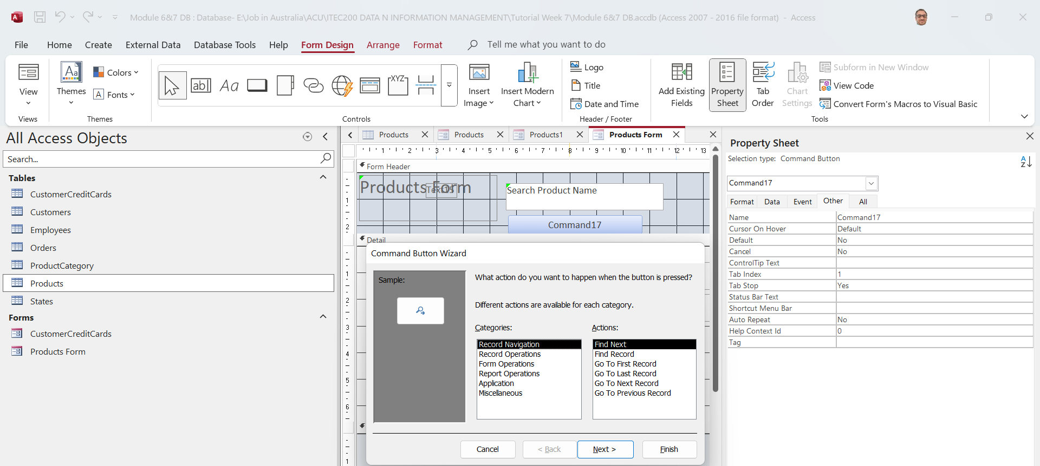
Hands-On Activity 2: Building a Products Form with Search
Draw it next to the text box.
The Command Button Wizard will open:
Choose Form Operations → Apply Form Filter → Next → Finish.

Slide 45
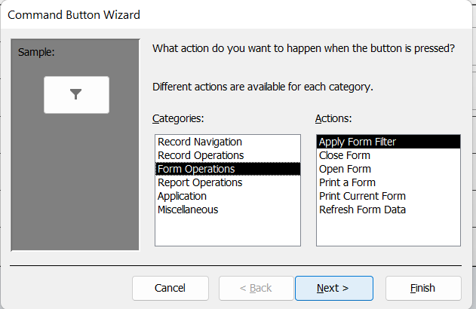
Hands-On Activity 2: Building a Products Form with Search
Draw it next to the text box.
The Command Button Wizard will open:
Choose Form Operations → Apply Form Filter → Next → Finish.

Slide 46
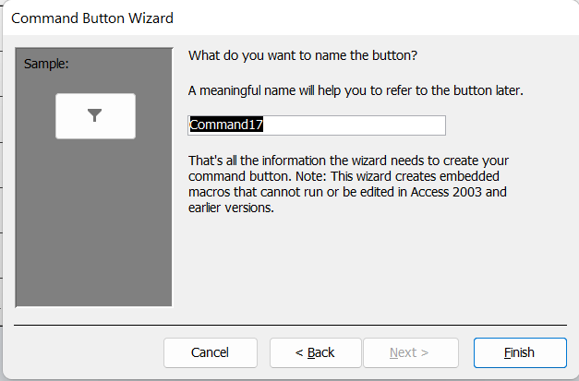
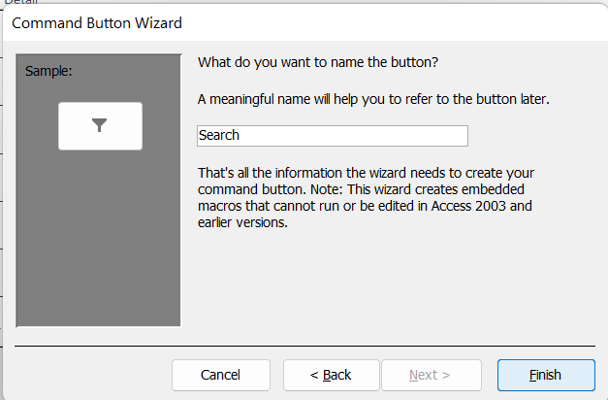
Hands-On Activity 2: Building a Products Form with Search
A new button will appear in your form.
Enter Search

Slide 47
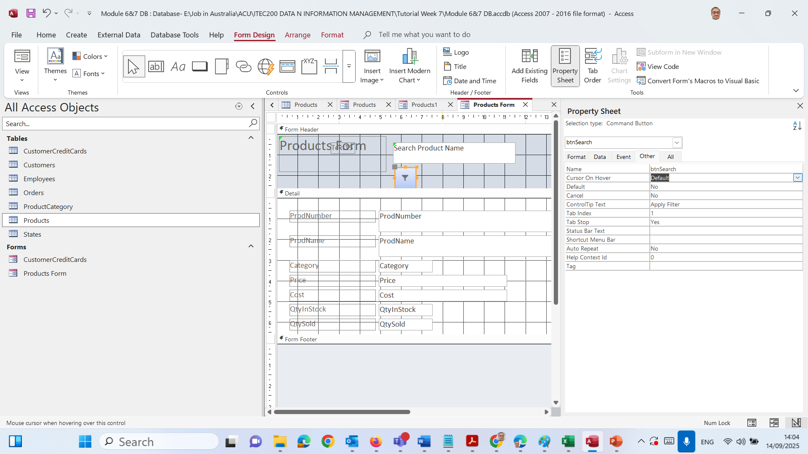
Hands-On Activity 2: Building a Products Form with Search
After you click Finish, you can still adjust the Name in the Property Sheet → Other tab to btnSearch (this is the internal name Access uses).

Slide 48
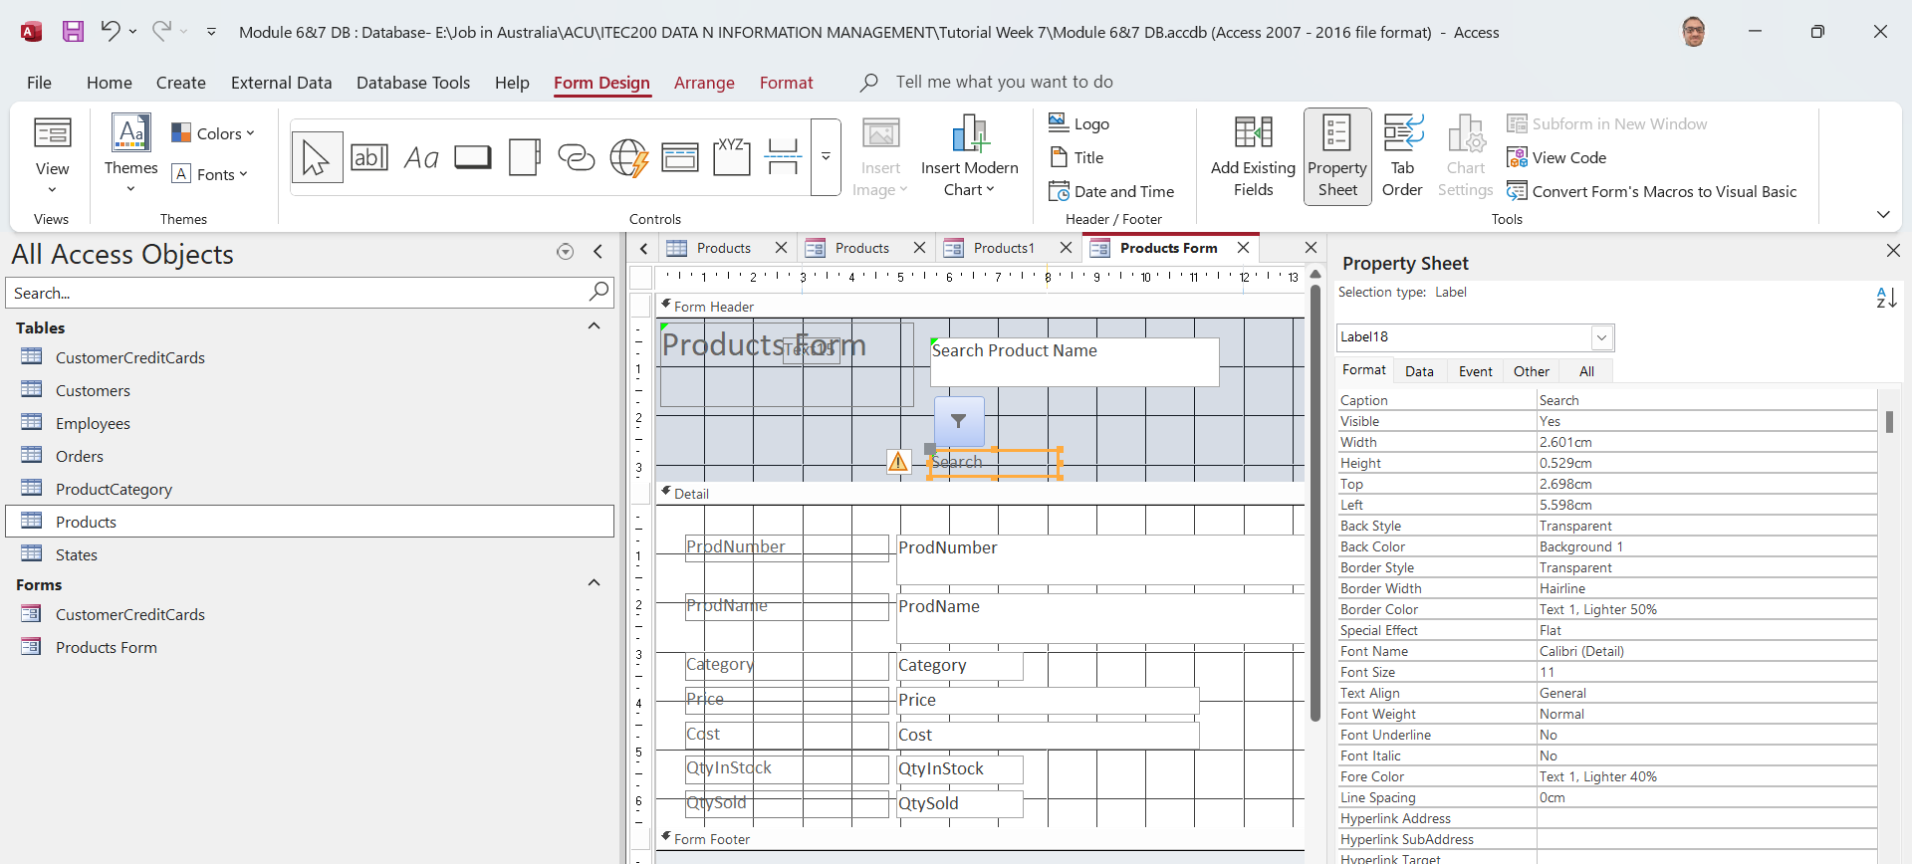
Hands-On Activity 2: Building a Products Form with Search
Adjust the Button Properties
Select the new button → look at the Property Sheet (on the right).
Under Other: change Name to btnSearch.
Under Format: change Caption to Search

Slide 49
Hands-On Activity 2: Building a Products Form with Search
Wire the Filter (make it actually search)
With the button still selected → Property Sheet → Event tab.
In On Click, click the … button → choose Macro Builder.

Slide 50
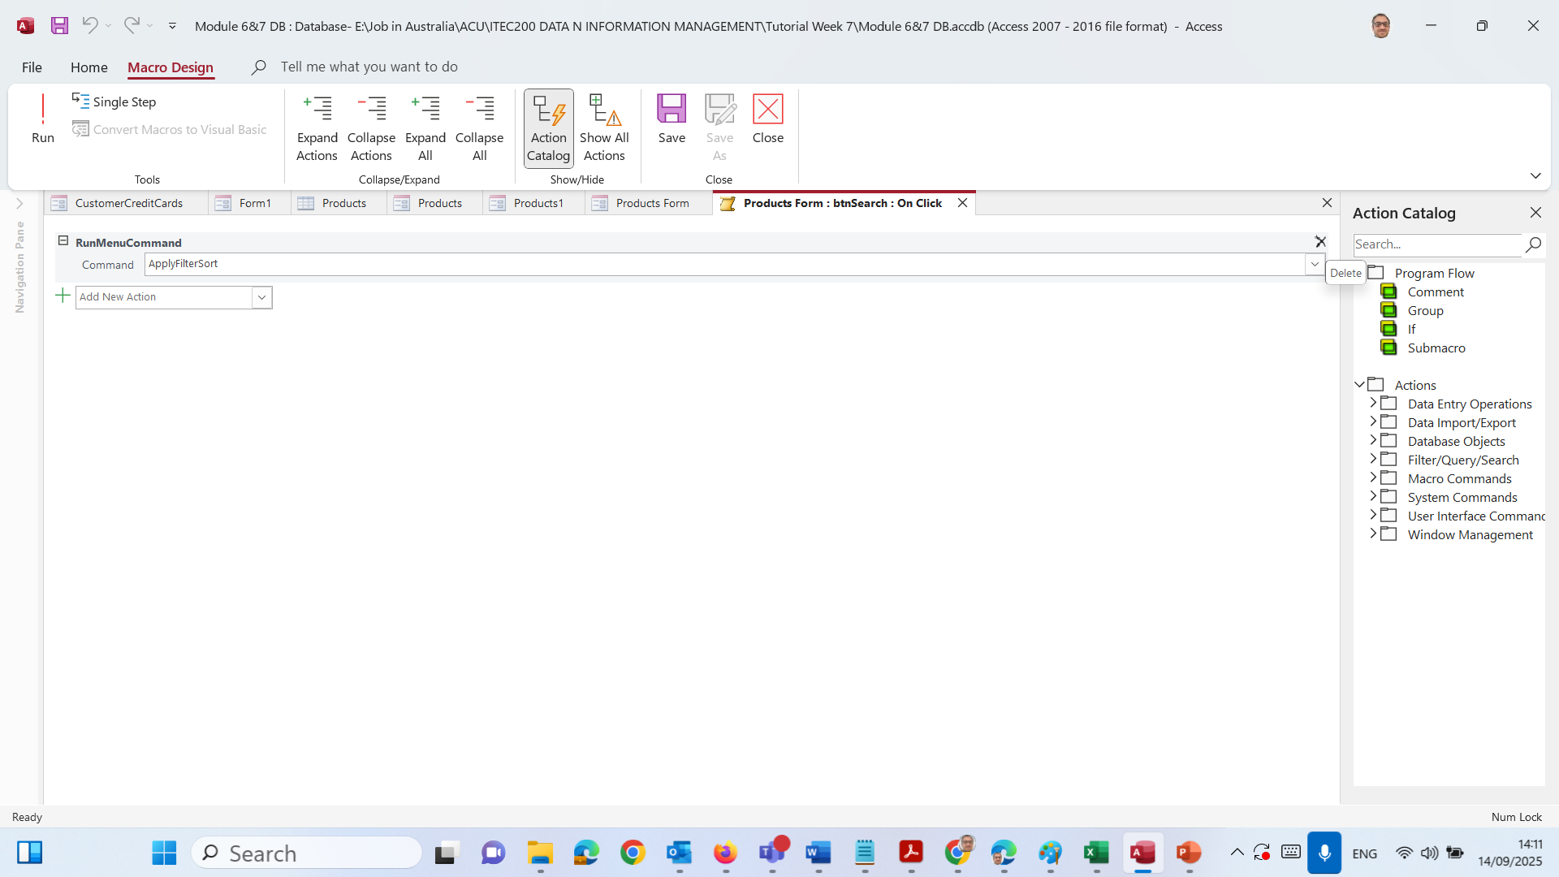
Hands-On Activity 2: Building a Products Form with Search
In the macro window:
Remove the default action (if you see RunMenuCommand / ApplyFilterSort):
Click the gray bar to the left of that row → press Delete.

Slide 51
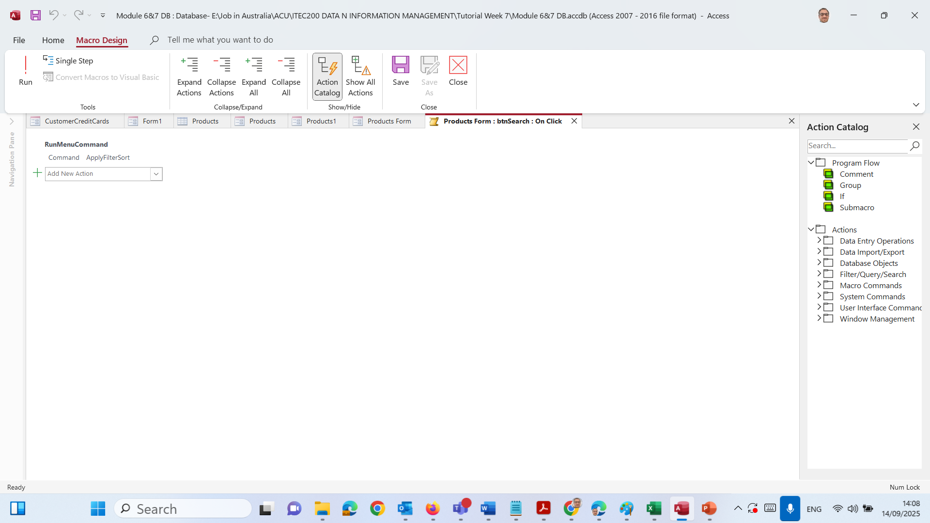
Hands-On Activity 2: Building a Products Form with Search
Add the right action:
Click Add New Action → choose ApplyFilter.

Slide 52

Hands-On Activity 2: Building a Products Form with Search
Fill the action details (you’ll see fields for the action):
Filter Name: leave blank.
Where Condition: type exactly:
[ProdName] Like "*" & [txtSearchProduct] & "*"
We use our actual field name — in your table it’s ProdName — and your text box name txtSearchProduct.)

Slide 53
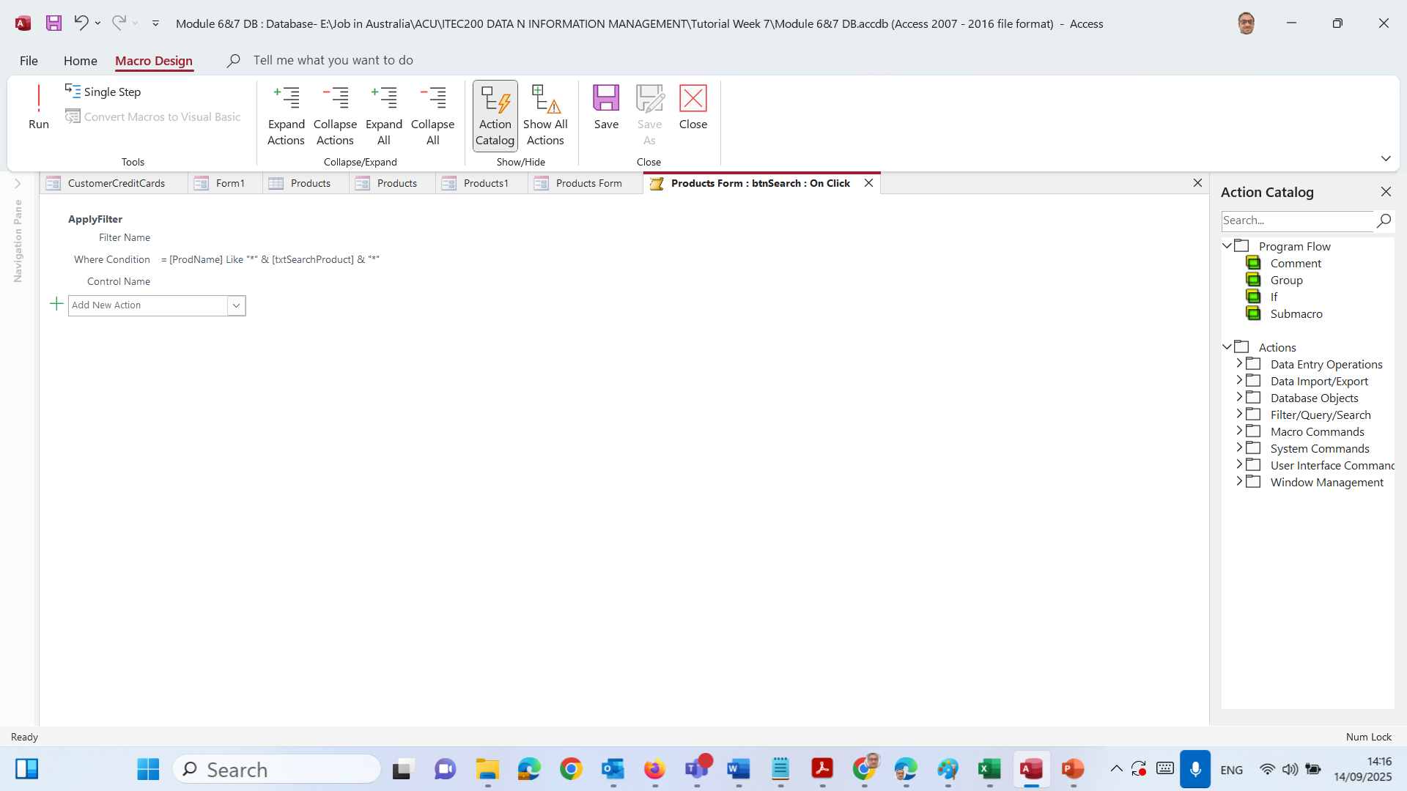
Hands-On Activity 2: Building a Products Form with Search
Save the macro:
Click Save (or press Ctrl+S) → click Close.

Slide 54
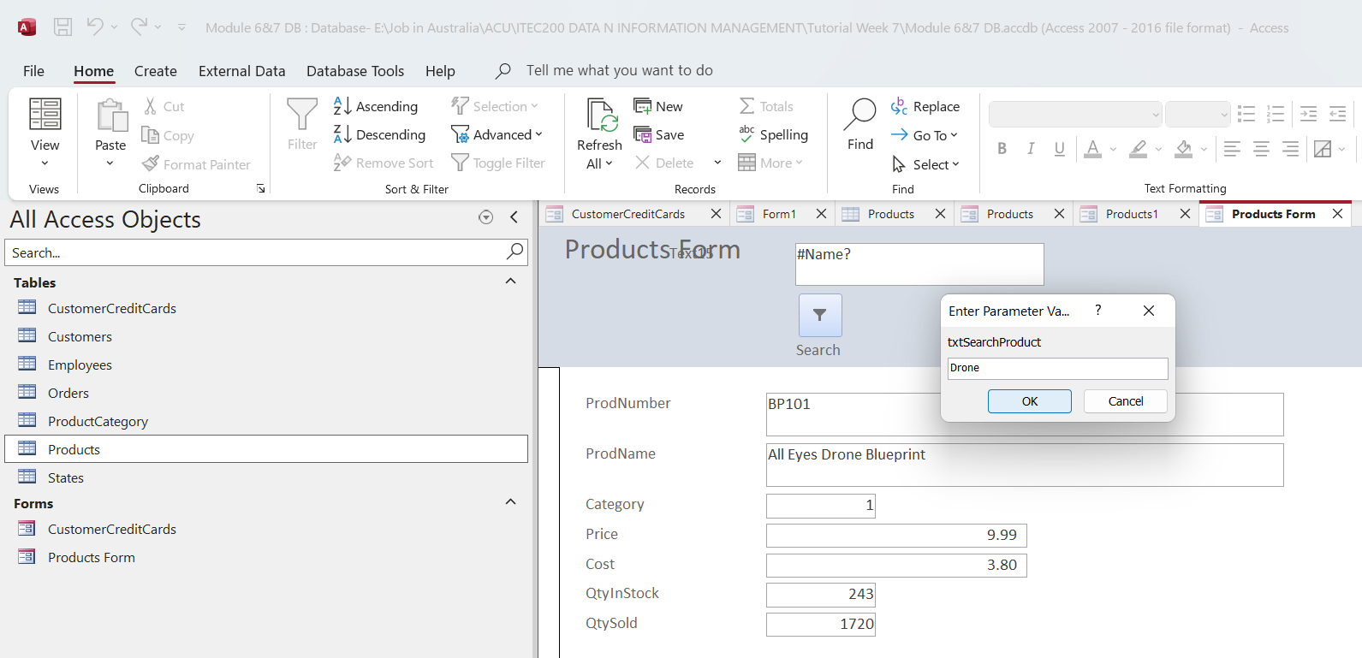
Hands-On Activity 2: Building a Products Form with Search
Test it
Switch the form to Form View.
In Search Product Name, type part of a name (e.g., Drone).

Slide 55
Hands-On Activity 2: Building a Products Form with Search
Click Search → the form should show only matching products.

Slide 56

Hands-On Activity 2: Building a Products Form with Search
Or search for Robot

Slide 57
Compare Wizard vs Design View
Wizard (what you built first) | Design View (what you added)
Fast, automatic form | Manual layout and controls
Limited flexibility | Full customisation (search, dropdowns, styling)
Good for beginners | Best for polished results

Slide 58
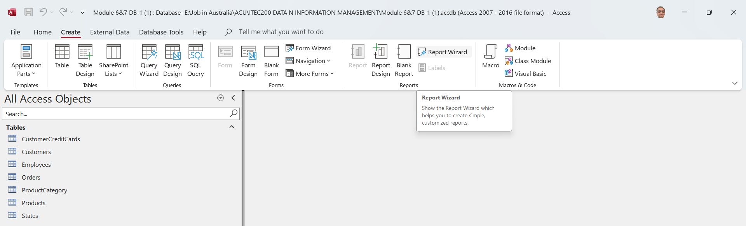
Reports — Customers with their Orders
A. Build the report (Report Wizard)
Go to Create → Report Wizard.

Slide 59
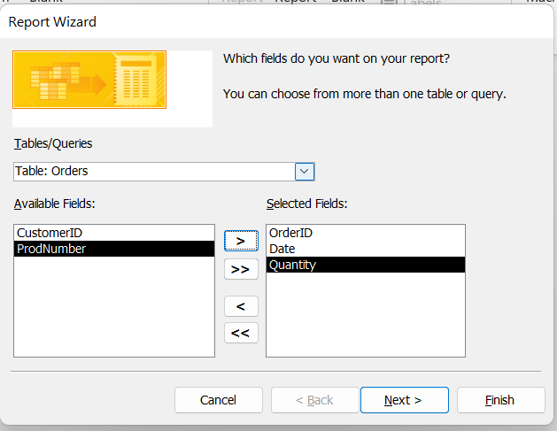
Reports — Customers with their Orders
In Tables/Queries, choose Table: Orders.
Add these fields (use what exists in your DB):
From Orders: OrderID, Date, Quantity

Slide 60
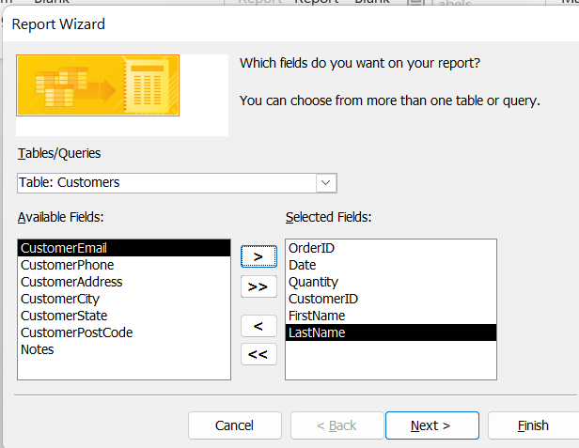
Reports — Customers with their Orders
From Customers (expand it in the list): CustomerID or FirstName, LastName

Slide 61
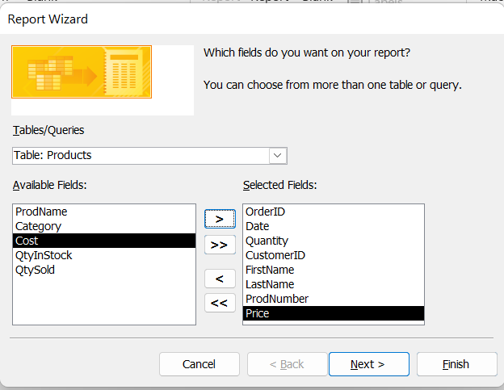
Reports — Customers with their Orders
From Products: ProdName, Price

Slide 62
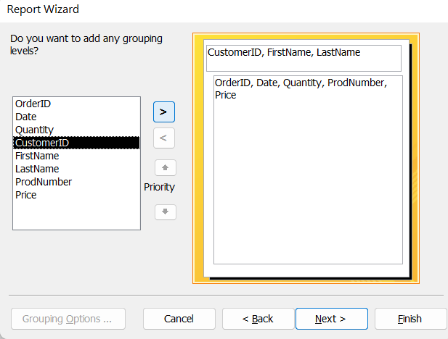
Reports — Customers with their Orders
Click the > button → this moves it into the “grouping levels” box.
This means all orders will be grouped under each customer.

Slide 63
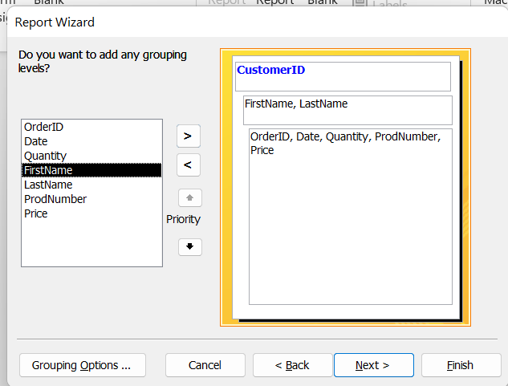
Reports — Customers with their Orders
Click Next
Sort by Date (Ascending)
Click Next.

Slide 64
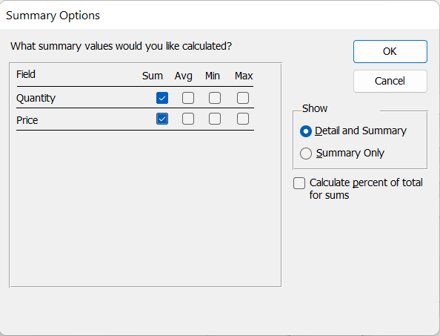
Reports — Customers with their Orders
Add Summary Options… → tick Sum for Quantity (and Price).
Finish → your grouped report will open.

Slide 65
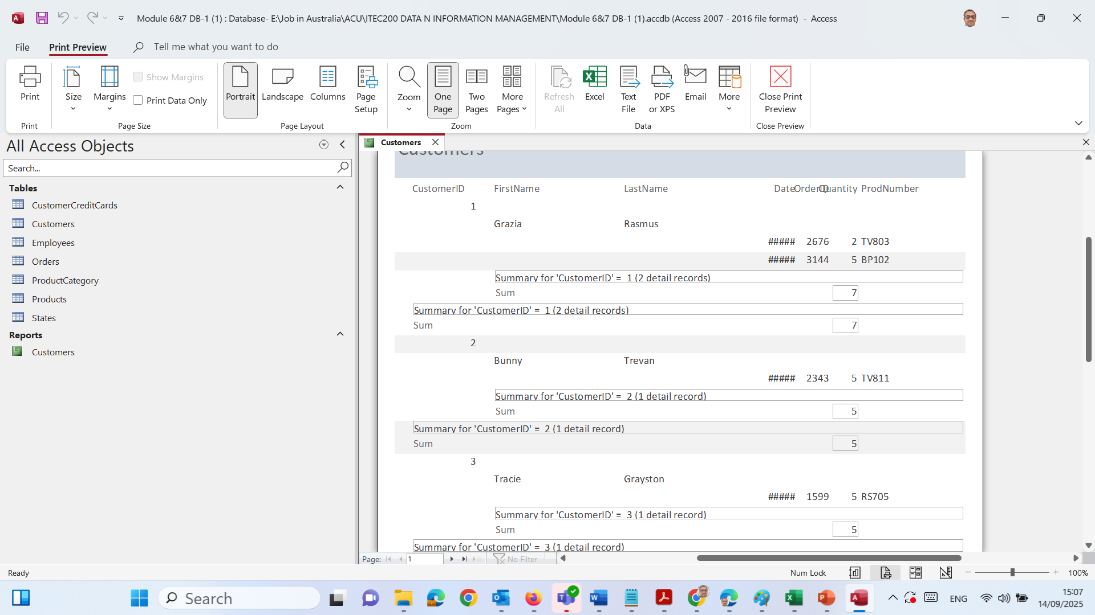
Each Customer is listed with their Orders.
At the bottom of each customer section, you see a Sum of Quantity (total items they ordered).
It’s basically showing: Customer → Orders → Total per Customer.

Slide 66
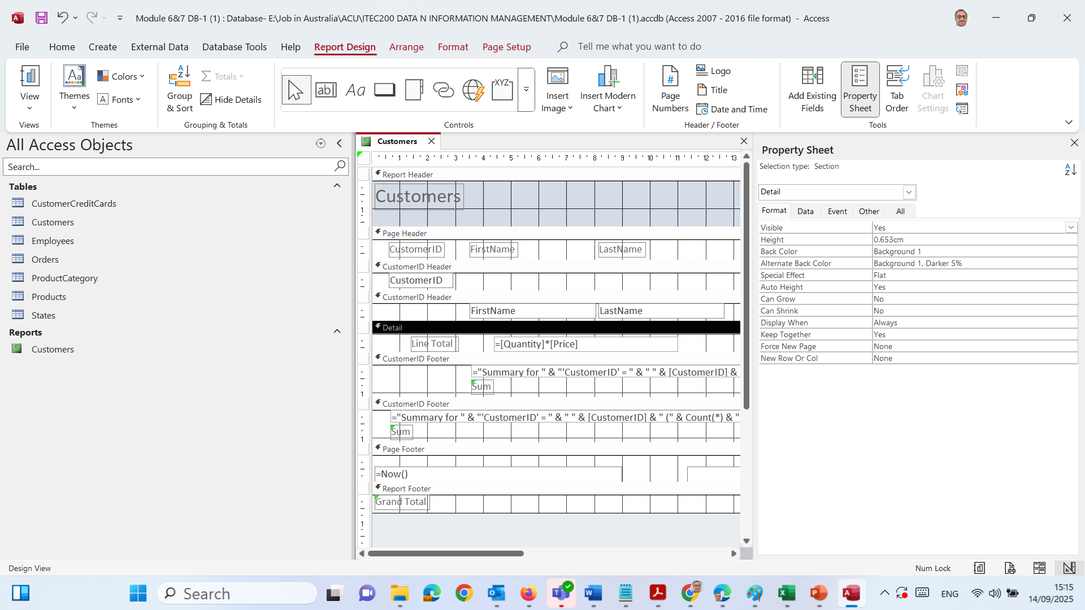
Reports — Customers with their Orders
Add a line total (optional but nice)
Switch to Design View.
In the Detail section, add a Text Box to the right of Quantity.

Slide 67
Reports — Customers with their Orders
Set its Control Source to: =[Quantity]*[Price]
Set Format = Currency.
Change the label to Line Total.

Slide 68
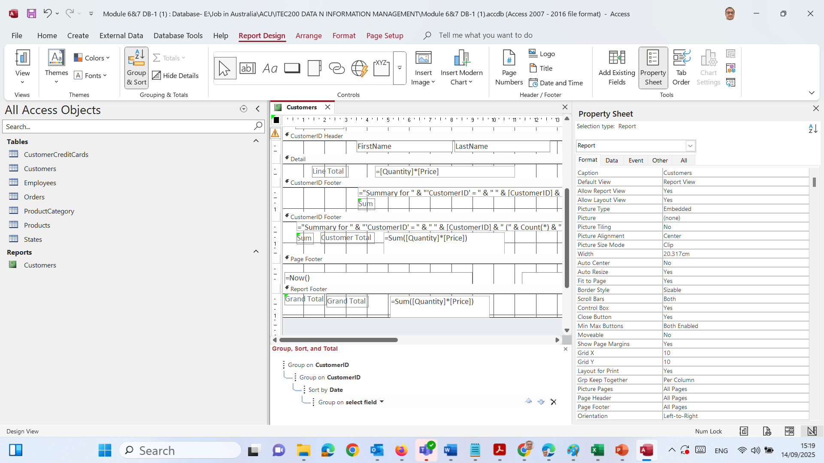
Reports — Customers with their Orders
Add totals per customer + grand total
Ensure you have a Customer Footer (Report Wizard usually adds it). If not: Design → Group & Sort → add a group on customer and show Footer.
In the Customer Footer, add a Text Box with Control Source:
=Sum([Quantity]*[Price])
Label it Customer Total, Format = Currency.

Slide 69
Reports — Customers with their Orders
In the Report Footer, add another Text Box with:
=Sum([Quantity]*[Price])
Label it Grand Total, Format = Currency.

Slide 70

Reports — Customers with their Orders
Format the report
Design → Logo → insert your ACU logo (place it in the Report Header).
Click the report title → increase font size / bold.
Use Themes → Colors/Fonts for a clean look.
Print Preview to check margins and page breaks.

Slide 71

Reports — Customers with their Orders
Format the report
Design → Logo → insert your ACU logo (place it in the Report Header).
Click the report title → increase font size / bold.
Use Themes → Colors/Fonts for a clean look.
Print Preview to check margins and page breaks.

Slide 72

Reports — Customers with their Orders
Format the report
Design → Logo → insert your ACU logo (place it in the Report Header).
Click the report title → increase font size / bold.
Use Themes → Colors/Fonts for a clean look.
Print Preview to check margins and page breaks.

Slide 73

Reports — Customers with their Orders
Format the report
Design → Logo → insert your ACU logo (place it in the Report Header).
Click the report title → increase font size / bold.
Use Themes → Colors/Fonts for a clean look.
Print Preview to check margins and page breaks.

Slide 74

Compact/Repair, Password, Backup
A. Compact & Repair
Close open objects (tables/forms/reports) if prompted.
Go to Database Tools → Compact and Repair Database.
What it does: cleans up the file and fixes small issues.

Slide 75

Compact/Repair, Password, Backup

Slide 76

Compact/Repair, Password, Backup
B. Add a password (demo)
Open File Exclusive → Info → Encrypt with Password.

Slide 77

Compact/Repair, Password, Backup
Enter a strong password → OK.
Note: Don’t forget it. You’ll need it every time you open the DB.
To remove: File → Info → Decrypt Database (enter current password).

Slide 78

Compact/Repair, Password, Backup
Enter a strong password → OK.
Note: Don’t forget it. You’ll need it every time you open the DB.
To remove: File → Info → Decrypt Database (enter current password).

Slide 79

Compact/Repair, Password, Backup
C. Make a backup copy
File → Save As → Back Up Database.
Choose your folder (e.g., a “Backups” folder) → Save.
You’ll get a date-stamped .accdb copy.

Slide 80

Compact/Repair, Password, Backup
C. Make a backup copy
File → Save As → Back Up Database.
Choose your folder (e.g., a “Backups” folder) → Save.
You’ll get a date-stamped .accdb copy.

Slide 81
Tutorial Preparation (Week 7)
Step-by-step:
Download MS Access (Office 365 / University license). (For Download and install refer to Week 6)
Open the provided sample database.
If security warning appears → add folder to Trusted Locations.
Save as Week7_yourname.accdb.

Slide 82
Tutorial Preparation (Week 7)
You will build Forms & Reports:
Customer Form (refine fonts, colours, layout).
Product Form (add search dropdown).
Employee Form (refine for readability).
Customer Orders Form (main + subform).
Employee Report (group by department).
Customer Orders Report (totals, new page per customer).
Main Menu Form with navigation buttons + student details.

Slide 83
What to Submit
Completed Access database with forms & reports.
Screenshots of each form & report.
Main Menu form with student name & ID.

Slide 84
What to Avoid
X Submitting tables only (no forms/reports). X Leaving default layouts (ugly/unprofessional). X Missing student name/ID in the Main Menu form.

Slide 85
Discussion & Debate Questions
Q: Should forms allow cascade delete (e.g., deleting a customer removes all their orders)?
Yes side: Keeps data clean.
No side: Dangerous, might lose important history.
Q: Should reports always show all details, or just summaries?
Depends on audience: Managers may want summaries, auditors need details.

Slide 86
Problem-Solving Examples
Problem: Customer form allows empty postcode.
Fix: Set Required = Yes and Input Mask = 0000.
Problem: Report shows all employees, but you need only NSW staff.
Fix: Add filter State = "NSW".

Slide 87

Let’s Answer Your Questions
Live during class – Ask directly during sessions.
Canvas Inbox – For structured academic queries.
Email – For formal communications or attachments.
Microsoft Team – Send a reminder if I did not reply after 3 business day

Slide 88

Happy Learning and Bright Futures Ahead! Dr. Farshid Keivanian Stay Connected: linkedin.com/in/farshid-keivanian github.com/FarshidKeivanian
Education is the most powerful weapon you can use to change the world. — Nelson Mandela

Slide 89
Thank You
Have a Great Learning Day!
Feel free to reach out with any questions!
Dr. Farshid Keivanian

Slide 90
Attendance

